Slide 1
Care4Me

Slide 2
Problem
Cost for healthcare is increasing
Long waiting times
High stress levels among medical personnel
Language barriers
Physical hindrance
Notes:
Problem
Today a lot of people seeks helps from healthcare professionals when they actually could with selfhelp get better.
Today we have apps that provide digital consultations and Some of the problems in the Swedish health care system are:
Cost for healthcare is increasing
Long waiting times
High stress levels among medical personnel
Language barriers
Physical hindrance
Even if we have apps that can provide quicker access to healthcare professionals we also see an increase of people connected through the apps even if they could solve it via selfcare. We have created an intermediate using AI and voice to gather information from trusted sources and AI bot asking relevant questions to provide a self care plan or connect to clinic (if needed)

Slide 3
Solution
Patient speaks into the device using preferred language
04
Patient chooses healthcare provider
05
01
04
01
03
AI analysis info in real time from trusted sources and clarifies the needs by asking control questions
AI redirect to self treatment plan or healthcare provider
02
03
02
Notes:
Our solution
inclusive and multilingual solution platform that provides relevant, high-quality information to the patients in their language and on their conditions in voice and text format in the form of chat bot
The quality will be ensured by trusted health sources? Our solution is based on existing technology.
There will also be a feedback form that each consumer can fill in to improve the customer quality
Making sure that people with different kind of difficulties like physical and verbal disability to be able to seek care through voice to text
Revenue streams

Slide 4
Future Plans
Global expansion
Identity management and secure data using Blockchain technology
Matchmaking service - where patients can find healthcare providers
Pool of care seekers for research purposes
Interoperability with other apps (Health apps)
Notes:
Expansion to other markets
Identity management and secure data using Blockchain technology
Patient decides what data to share and in the future can also sell data to researchers if they choose to.
Matchmaking service - where private clinics are connected to the platform. Where each advertisement and connection results in revenue
Care4Me can in the future provide a pool of care seekers that would be of interest to researchers that are searching for a certain population
Interoperability with other apps/platforms such as health apps

Slide 5
The Care4Me Team
Heaven Bereket
Nabi Amanuel
Raffi Avakian
Saron Zeru
Shannet Fessehazion
Contact: partner@unitech.one

Slide 6
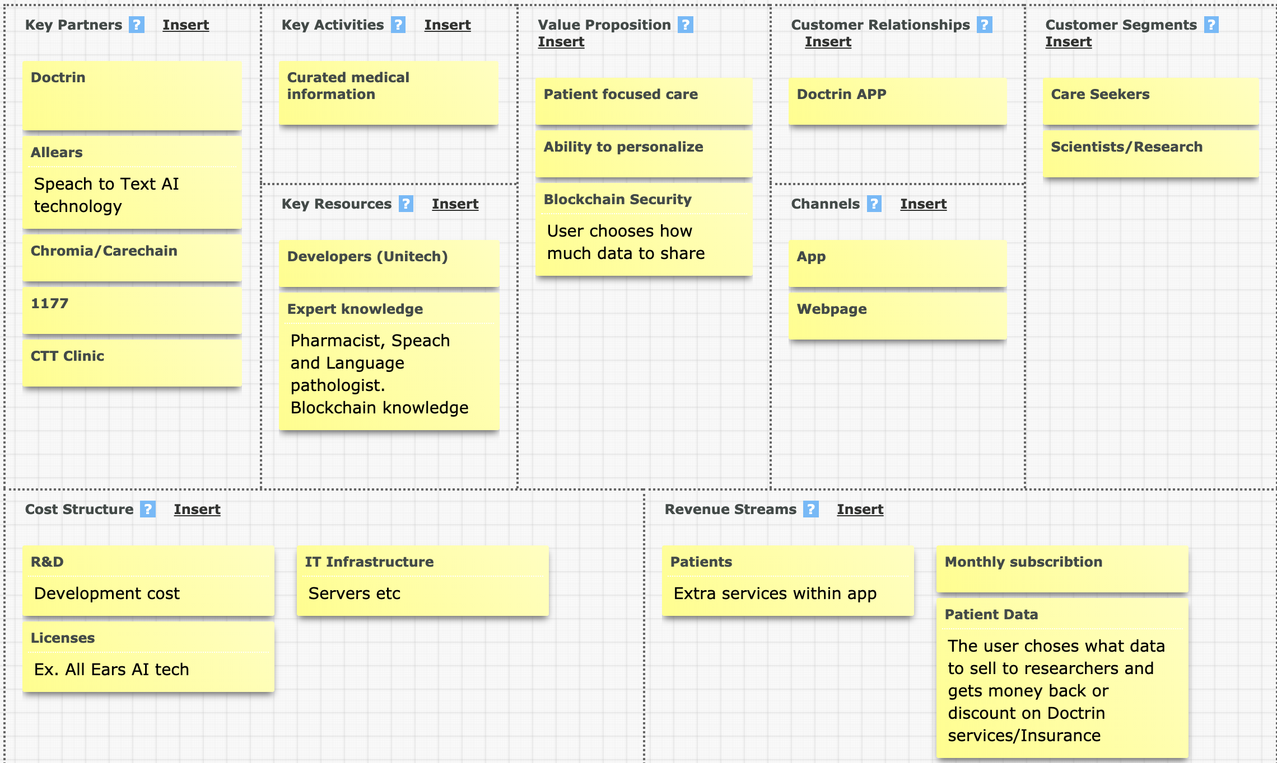
Notes:
Business Model Canvas

